Slide 1


DEPI
Uk Railways journeys Analysis

Slide 2








Our Team
Hamed Abdelaziz
Ahmed Sayed
Mohamed Saber
Amira Reda
Ethar Mostafa
Shahd Mohamed

Slide 3


Overview
Goal: Turn complex UK railway data into actionable insights to improve operations, revenue, and passenger experience.
Scope & Highlights:
Processed 70K+ records: trips, tickets, delays, cancellations, revenue
Built data model linking trips, stations, ticket types, payments, KPIs
Developed interactive dashboards showing:
Revenue trends & top routes
On-time performance & delay causes
Booking patterns & payment methods
Passenger activity & refunds
Achievements:
Identified key causes of delays & cancellations
Highlighted most profitable tickets & routes
Delivered data-driven insights for decision-making

Slide 4


Project Phases
01
Data Exploration
02
Data Cleaning
03
Feature Engineering & EDA
04
Data Modeling
05
Visualization & Dashboard Development

Slide 5



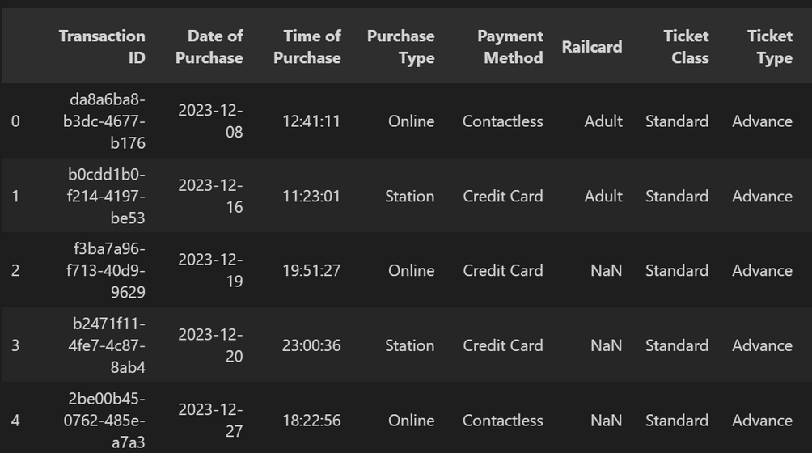
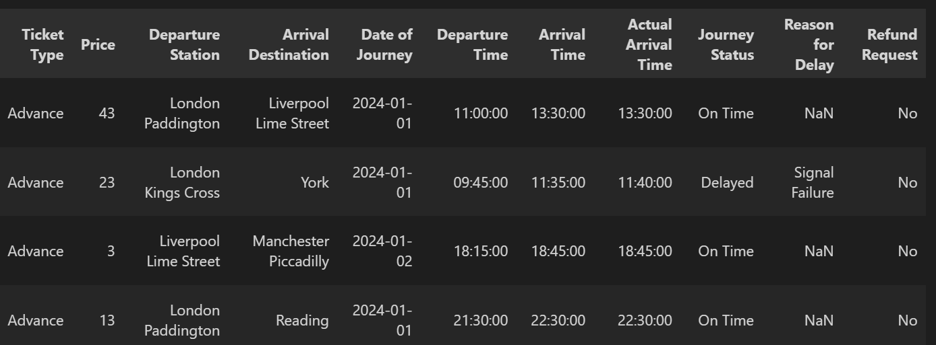
Data Exploration
Loaded and inspected raw data
(df.info(), df.head())
Checked data types and missing values (df.dtypes, df.isnull().sum())
Explored unique and repeated values per column
Identified duplicated rows (df.duplicated().sum())
Generated initial summary statistic

Slide 6
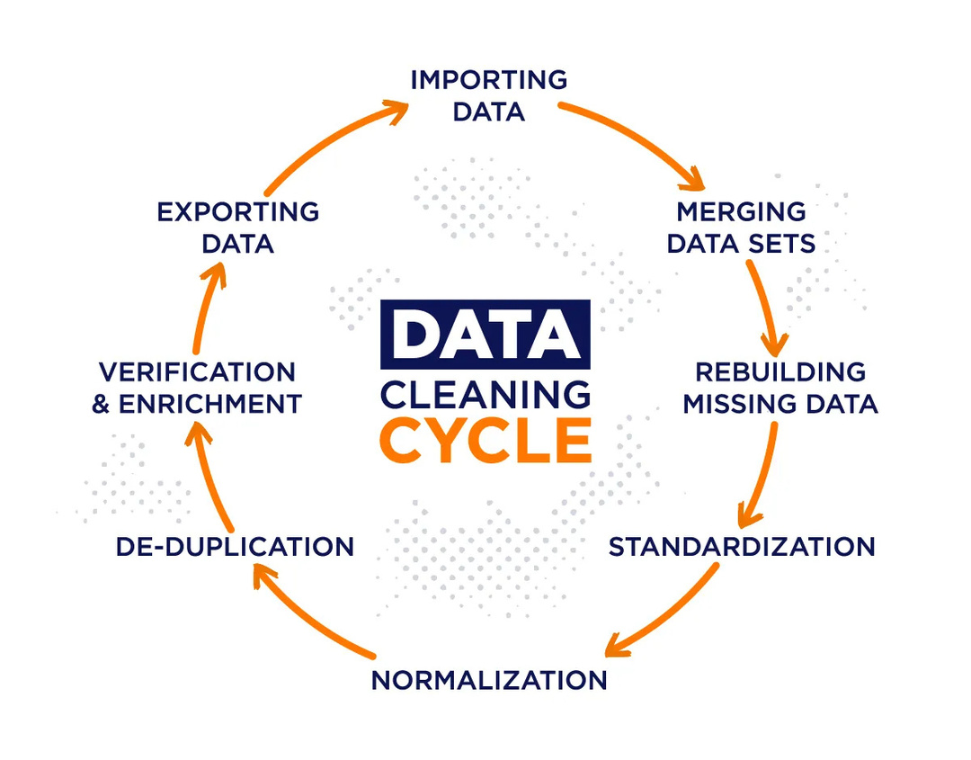
Data Cleaning
Converted Time & Date to datetime
df['Time of Purchase'] = pd.to_datetime(df['Time of Purchase'], format='%H:%M:%S')
df['Date of Purchase'] = pd.to_datetime(df['Date of Purchase'])
Filled missing Railcard values
df['Railcard'] = df['Railcard'].fillna('No Railcard')
Data ready for analysis
# Data is now consistent and ready for further step

Slide 7
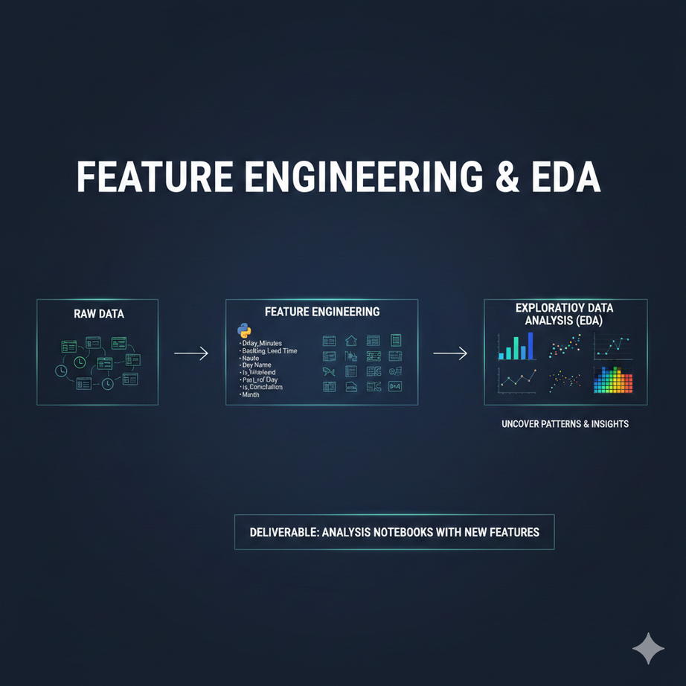
Feature Engineering & EDA
Created new insightful columns:
Delay_Minutes, Booking_Lead_Time, Route, Day Name, Is_Weekend, Part_of_Day, Is_Rush_Hour, Is_Cancellation, Month
Performed in-depth Exploratory Data Analysis (EDA) to uncover patterns and preliminary insights using Python
Deliverable: Analysis Notebooks with new features

Slide 8
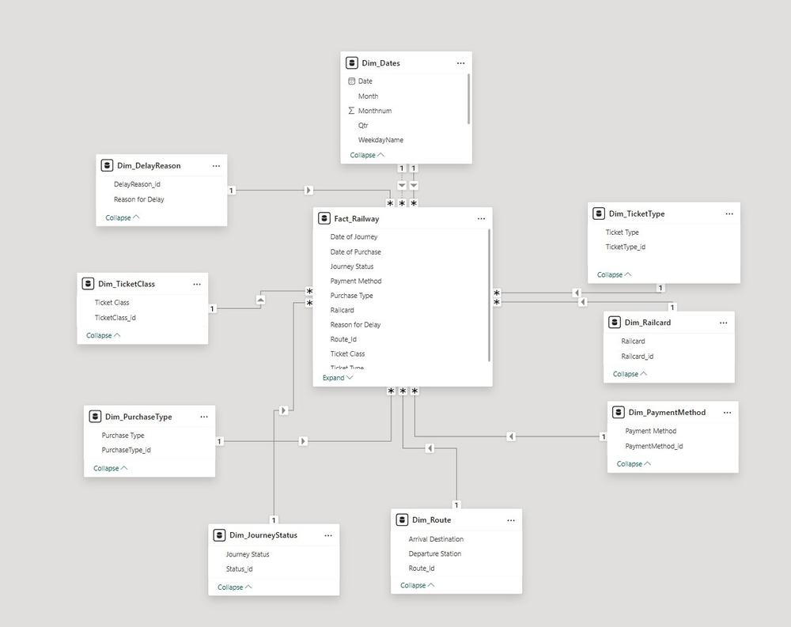
Data Modeling
Build star schema in Power BI
# Create dimension tables
Dim_Dates = df[['Date of Travel']].drop_duplicates()
Dim_Journey = df[['From','To']].drop_duplicates()
Define KPIs
Total_Tickets = df['Ticket ID'].count()
On_Time_Percentage = (df['Status'] == 'On
Time').mean() * 100

Slide 9
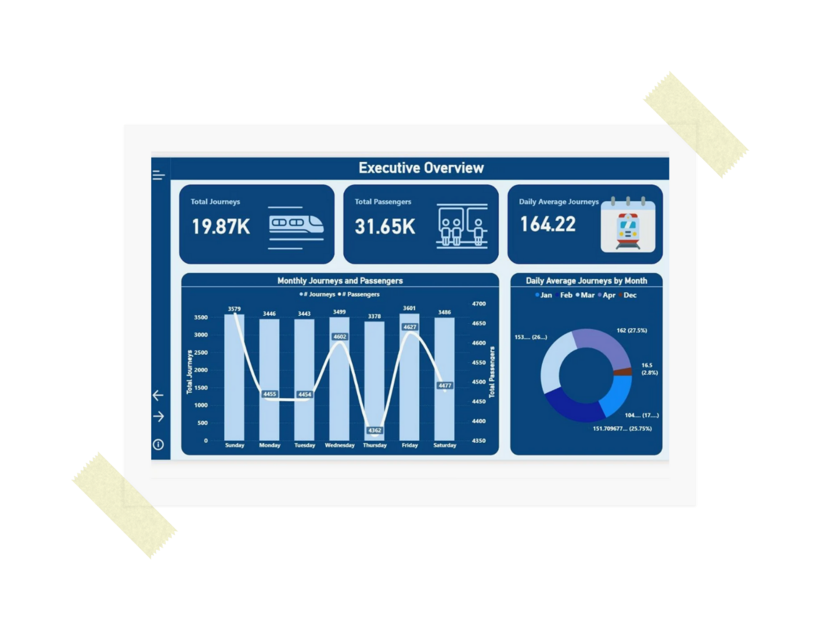
Visualization & Dashboard Development
Create interactive dashboards in Power BI
Develop key DAX measures for KPIs
Incorporate advanced UI features (Navigation Panels, Bookmarks, Tooltips)
Deliverable: Final .pbix Dashboard

Slide 10







Dashboard Highlights
Tickets & Revenues
Advance tickets sold: 18K; Peak time: 9K
Avg. ticket price: $23.4
Highest revenue day: Sunday ($120K)
Most profitable route: London → York
Performance & Delays
On-time trips: 90.68%
Delayed: 5.34%; Cancelled: 3.98%
Top delay causes: Signal, Staff, Weather
Booking & Payment
Online bookings: 19K; Station: 13K
On-day bookings highest: 28K
Main payments: Debit Card 60.66%, Contactless 34.23%
Refunds
Refund rate: 3.54% (164 requests)
Main reasons: Cancellation 52.44%, Delay 47.56%
Most refunded: Standard clas

Slide 11









Key Insights
Most delays caused by Signal issues, Staffing, and Weather
Advance tickets contribute most to revenue
Sunday is the busiest day for passengers and trips
Online and on-day bookings dominate purchase behavior
Standard class tickets have the highest refund request

Slide 12












Recommendations
Focus on improving signal and staffing efficiency to reduce delays
Promote advance ticket sales to boost revenue further
Enhance online booking system and payment options
Monitor peak days closely for operational planning
Implement targeted refund policies for high-demand ticket types

Slide 13


Thanks!
Do you have any questions?

